Slide 1

Pennant Technologies Private Limited
Exception Handling in Java

Slide 4
Exception Handling in Java
Dictionary Meaning: Exception is an abnormal condition.
The Exception Handling in Java is one of the powerful mechanism to handle the runtime errors so that the normal flow of the application can be maintained.
Exception Handling is a mechanism to handle runtime errors such as ClassNotFoundException, IOException, SQLException, RemoteException, etc.
An exception is an error event that can happen during the execution of a program and disrupts its normal flow.
Java provides a robust and object-oriented way to handle exception scenarios known as Java Exception Handling.
Exception handling in java helps in minimizing exceptions and helps in recovering from exceptions.
It is one of the powerful mechanisms to handle runtime exceptions and makes it bug-free.
Exception handling helps in maintaining the flow of the program.

Slide 5
Exception handling in java with an example:
Let’s say,
statement
statement
exception ………… an exception occurred, then JVM will handle it and will exit the prog.
statement
statement
For handling exceptions, there are 2 possible approaches
1. JVM: If an exception is not handled explicitly, then JVM takes the responsibility of handling the exception.
Once the exception is handled, JVM will halt the program and no more execution of code will take place
Example: import java.util.*;
class Main {
public static void main (String[] args) {
System.out.println(5/0);
System.out.println("End of program!");} }
Runtime Error: Exception in thread "main" java.lang.ArithmeticException: / by zero at Main.main(File.java:5)
2. Developer: Developers can explicitly write the implementation for handling the exception. Once an exception is handled, the normal execution of code will continue.
Preferable: handle exceptions to ensure your code gets executed normally.

Slide 6
Java Exception Hierarchy
Exception Hierarchy – Following is the Exception Handling in Java handling hierarchy.
Throwable –
It is the root class for the exception hierarchy in java.
It is in the java.lang package.
Error –
Subclass of Throwable.
Consist of abnormal condition that is out of one’s control and depends on the environment
They can’t be handled and will always result in the halting of the program.
Eg: StackOverFlowError that can happen in infinite loop or recursion
Exception –
Subclass of Throwable.
Consist of abnormal conditions that can be handled explicitly.
If one handles the exception then our code will continue to execute smoothly.

Slide 7
Types of exception in Java
Checked Exceptions
Those exceptions that are checked at compile-time comprises checked exceptions.
They are child classes of Exception except for RuntimeException.
The program will not compile if they are not handled.
Example: IOException, ClassNotFoundException, etc.
Unchecked Exceptions
Those exceptions that are checked at runtime comprises unchecked exceptions.
They are child classes of RuntimeException.
They give runtime errors if not handled explicitly.
Example: ArithmeticException, NullPointerException etc.

Slide 8
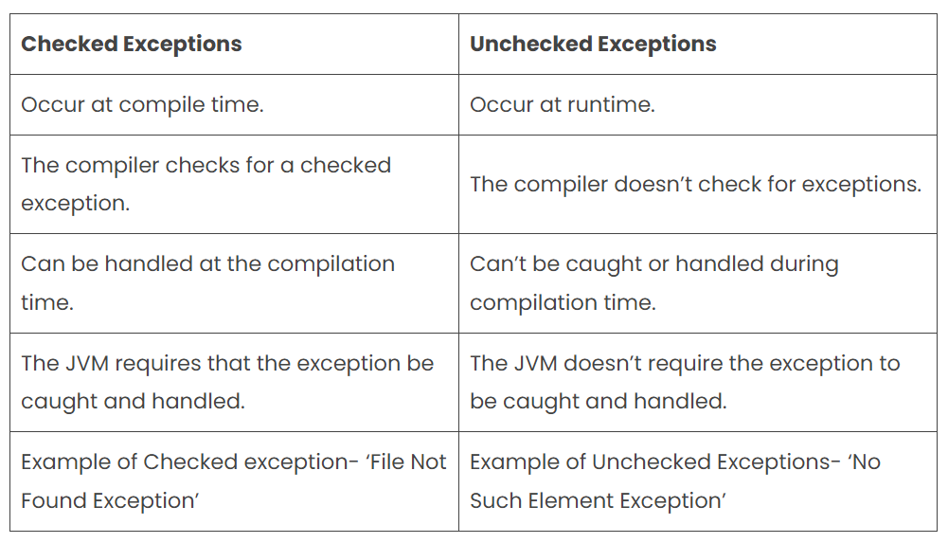
Difference between Checked and Unchecked Exception

Slide 9
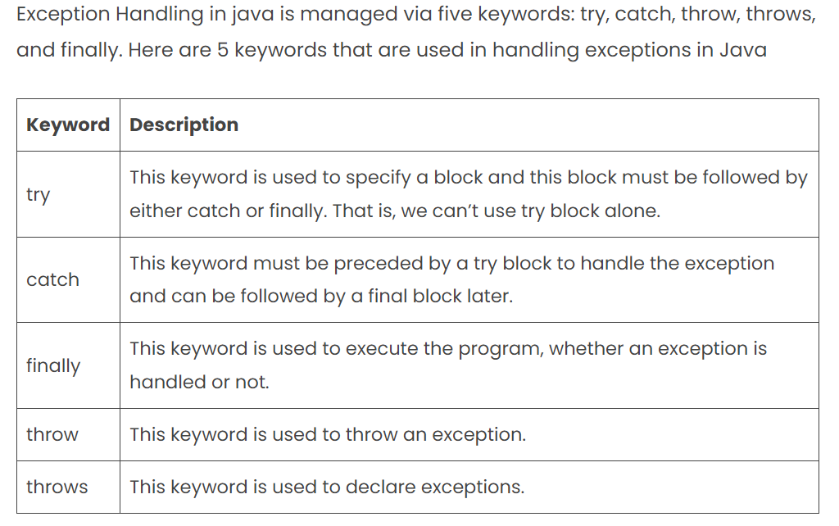
Java Exception Keywords

Slide 10
Java Try-Catch Block
Try-catch syntax: try{}
catch(Exception e){}
Try-catch Example: public class ExceptionDemo {
public static void main (String[] args) {
int a=10;
for(int i=3;i>=0;i--)
try{
System.out.println(a/i);
}catch(ArithmeticException e){
System.out.println(e); } } }
Output:
3
5
10
java.lang.ArithmeticException: / by zero

Slide 11
try block contains the code that might throw an exception.
Don’t write anything extra in try as statements after the exception will not get executed if the exception occurred.
Try must be immediately followed by catch or finally block.
Eg: public class ExceptionDemo {
public static void main (String[] args) {
int a=10;
for(int i=3;i>=0;i--)
try{
System.out.println(a/i); } } }
Compile-time error: prog.java:5: error: 'try' without 'catch', 'finally' or resource declarations
try{
^
1 error

Slide 12
The catch block is used to catch the exception thrown by statements in the try block. The catch must follow try else it will give a compile-time error.
public class ExceptionDemo {
public static void main (String[] args) {
int a=10;
for(int i=3;i>=0;i--)
try{
System.out.println(a/i);
}
System.out.println("between try and catch");
catch(ArithmeticException e){
System.out.println(e); } } }
Compile Time Error: prog.java:5: error: 'try' without 'catch', 'finally' or resource declarations
try{
^
prog.java:9: error: 'catch' without 'try'
catch(ArithmeticException e){
^
2 errors

Slide 13
Things to Remember:
Do not keep any code after the statement which is prone to exception. Because if an exception occurred, it will straight away jump to the catch or finally block, ignoring all other statements in the try block.
class Main {
public static void main (String[] args) {
try {
System.out.println(4/0);
//will not get printed
System.out.println("end of try!"); }
catch(ArithmeticException e)
{
System.out.println("divide by 0"); } } }
Output: divide by 0
While catching the exception in the catch block, either you can have directly the class of exception or its superclass.

Slide 14
Exact Exception
class Main {
public static void main (String[] args) {
try{
System.out.println(4/0);
}
//ArithmeticException
catch(ArithmeticException e){
System.out.println("divide by 0");
}
}
}
Output: divide by 0

Slide 15
Example: Superclass of Exact Exception
class Main {
public static void main (String[] args) {
try{
System.out.println(4/0);
}
//superclass of ArithmeticException
catch(Exception e){
System.out.println("divide by 0");
}
}
}
Output: divide by 0

Slide 16
Java Multiple Catch Block
If you have multiple catches, you have to maintain the hierarchy from subclass to superclass.
Incorrect:
class Main {
public static void main (String[] args) {
try{
System.out.println(4/0);
}catch(Exception e)
{
System.out.println("Exception : divide by 0");
}catch(ArithmeticException e)
{
System.out.println("ArithmeticException :divide by 0"); } } }
Compile-time error: prog.java:11: error: exception ArithmeticException has already been caught
}catch(ArithmeticException e)
^
1 error

Slide 17
Correct example for Multi Catch Block
class Main {
public static void main (String[] args) {
try{
System.out.println(4/0);
}catch(ArithmeticException e)
{
System.out.println("ArithmeticException : divide by 0");
}catch(Exception e)
{
System.out.println("Exception : divide by 0");
} } }
Output: ArithmeticException: Divide by 0

Slide 18
Java Nested Try
When there is another try block within the try block:
class Main {
public static void main (String[] args) {
try{
try{
int[] a={1,2,3};
System.out.println(a[3]); }
catch(ArrayIndexOutOfBoundsException e) {
System.out.println("Out of bounds"); }
System.out.println(4/0); }
catch(ArithmeticException e) {
System.out.println("ArithmeticException : divide by 0"); } } }
Output: Out of bounds
ArithmeticException: Divide by 0

Slide 19
Note – If we put code of outer try before inner try, then if an exception occurred, it will ignore the entire inner try and move directly to its catch block.
class Main {
public static void main (String[] args) {
try{
System.out.println(4/0);
try{
int[] a={1,2,3};
System.out.println(a[3]); }
catch(ArrayIndexOutOfBoundsException e) {
System.out.println("Out of bounds"); } }
catch(ArithmeticException e) {
System.out.println("ArithmeticException : divide by 0"); } } }
Output: ArithmeticException: Divide by 0

Slide 20
Java Finally Block
Contains code that must be executed no matter if an exception is thrown or not. It contains code of file release, closing connections, etc.
Example: class Main {
public static void main (String[] args) {
try{
System.out.println(4/0); }
catch(Exception e) {
System.out.println(e); }
finally {
System.out.println("finally executed"); }
System.out.println("end"); } }
Output: java.lang.ArithmeticException: / by zero
finally executed
end

Slide 21
Finally Block
Finally, will execute even when we do not handle exceptions. Before halting the program, JVM checks if there is a “finally” block.
class Main {
public static void main (String[] args) {
try{
System.out.println(4/0); }
finally
{
System.out.println("cleaning......."); } } }
Runtime Error: Exception in thread "main" java.lang.ArithmeticException: / by zero at Main.main(File.java:4)
Output: cleaning.......

Slide 22
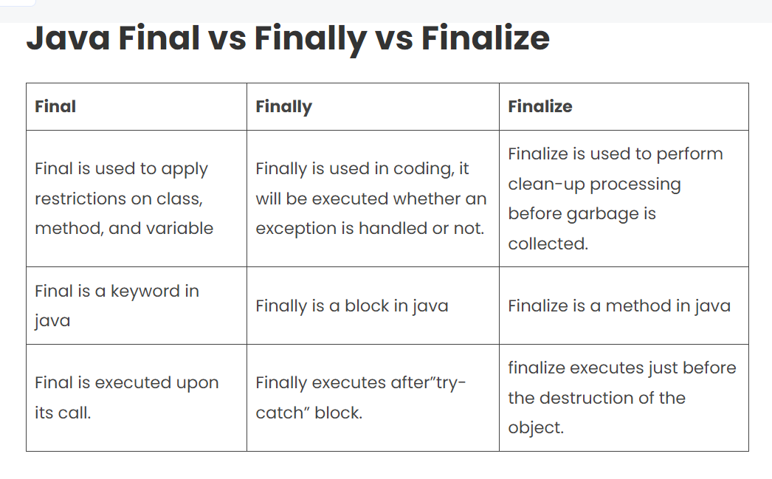

Slide 23
Java Throw Keyword
We can use throw where according to our logic an exception should occur.
Example: public class ExceptionDemo {
static void canVote(int age){
if(age<18)
try{
throw new Exception();
}catch(Exception e){
System.out.println("you are not an adult!"); }
else
System.out.println("you can vote!"); }
public static void main (String[] args) {
canVote(20);
canVote(10); } }
Output: you can vote!
you are not an adult!

Slide 24
Java Throws Keyword
Throws keyword is used when callee doesn’t want to handle the exception rather it wants to extend this responsibility of handling the exception to the caller of the function.
Basically says what sort of exception the code can throw and relies on the caller to handle it.
It is used to handle checked Exceptions as the compiler will not allow code to compile until they are handled.
Example: public class ExceptionDemo {
static void func(int a) throws Exception{
System.out.println(10/a); }
public static void main (String[] args) {
try{
func(10);
func(0);
}catch(Exception e){
System.out.println("can't divide by zero"); } } }
Output: 1
can't divide by zero

Slide 25
If callee can throw multiple exceptions, then all will be thrown simultaneously.
import java.util.*;
public class ExceptionDemo {
static void func(int a,int b) throws ArithmeticException, ArrayIndexOutOfBoundsException{
System.out.println(10/a);
int[] arr={1,2,3};
System.out.println(arr[b]); }
public static void main (String[] args) {
Scanner in=new Scanner(System.in);
for(int i=0;i<3;i++){
try{
func(in.nextInt(),in.nextInt());
}catch(ArithmeticException e){
System.out.println("can't divide by zero");
}catch(ArrayIndexOutOfBoundsException e){
System.out.println("Out of bounds!"); } } } }
Input: 2 1
0 1
2 3
Output: 5
2
can't divide by zero
5
Out of bounds!

Slide 26
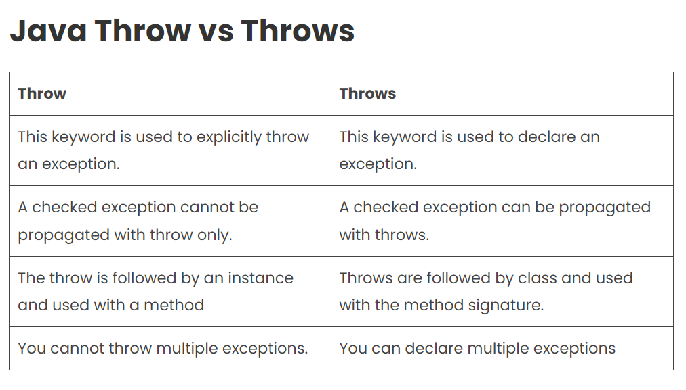

Slide 27
Java Custom Exception
You can create your own exception and give implementation as to how it should behave. Your exception will behave like a child’s class of Exception
Syntax: class YourException extends Exception{}
Example: let’s say, you are working with an airline company
You are in the luggage check-in department and as per rules, you can allow 15kg per customer.
So now more than 15kg of weight is an abnormal condition for us or in other words its an exception
This is our logic-based exception, so we’ll create our custom exception WeightLimitExceeded
As per syntax, it will extend Exception.
We define the constructor which will get invoked as soon as an exception will be thrown
We have to explicitly throw the exception and hence we will use throw keyword for that.
Using throws keyword is as per our need. If we are handling an exception where it is getting thrown then we can avoid throws, else we will use throws and handle it in the caller.

Slide 28
Implementation:
import java.util.*;
class WeightLimitExceeded extends Exception{
WeightLimitExceeded(int x){
System.out.print(Math.abs(15-x)+" kg : "); } }
class Main {
void validWeight(int weight) throws WeightLimitExceeded{
if(weight>15)
throw new WeightLimitExceeded(weight);
else
System.out.println("You are ready to fly!"); }
public static void main (String[] args) {
Main ob=new Main();
Scanner in=new Scanner(System.in);
for(int i=0;i<2;i++){
try{
ob.validWeight(in.nextInt());
}catch(WeightLimitExceeded e){
System.out.println(e); } } } }
Input: 20
7
Output: 5 kg : WeightLimitExceeded
You are ready to fly!

Slide 29
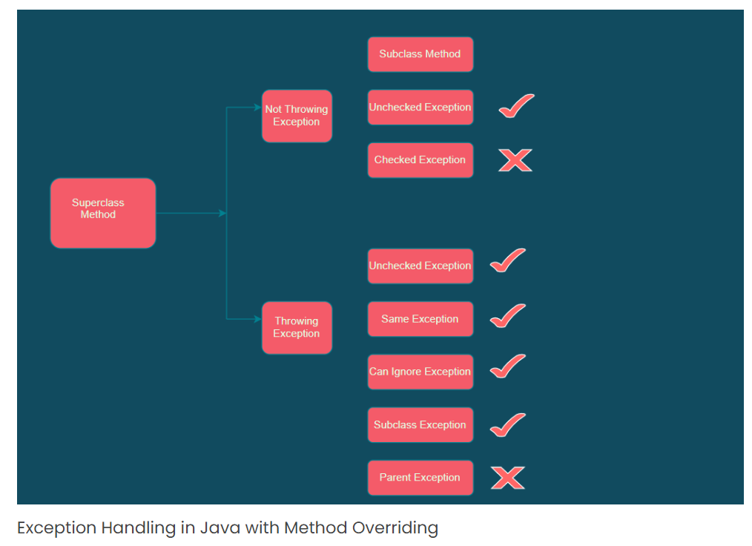
Exception Handling in java with method overriding
Exception Handling in Java with Method Overriding is an overridden method that declares to throw an exception and declare that it can throw the same exception or subtype of that exception.
To handle the exception in Java, you will have to follow three important rules.

Slide 30
Advantages and disadvantages of exception handling in java
Advantages of excepting handling in java
Separating Error-Handling Code from “Regular” Code
Propagating Errors Up the Call Stack
Grouping and Differentiating Error Types
Disadvantages of excepting handling in java
Experiencing unnecessary overhead
Not understanding how the application really works
Filling your logs with noisy events
Inability to focus on what actually matters

